Slide 1
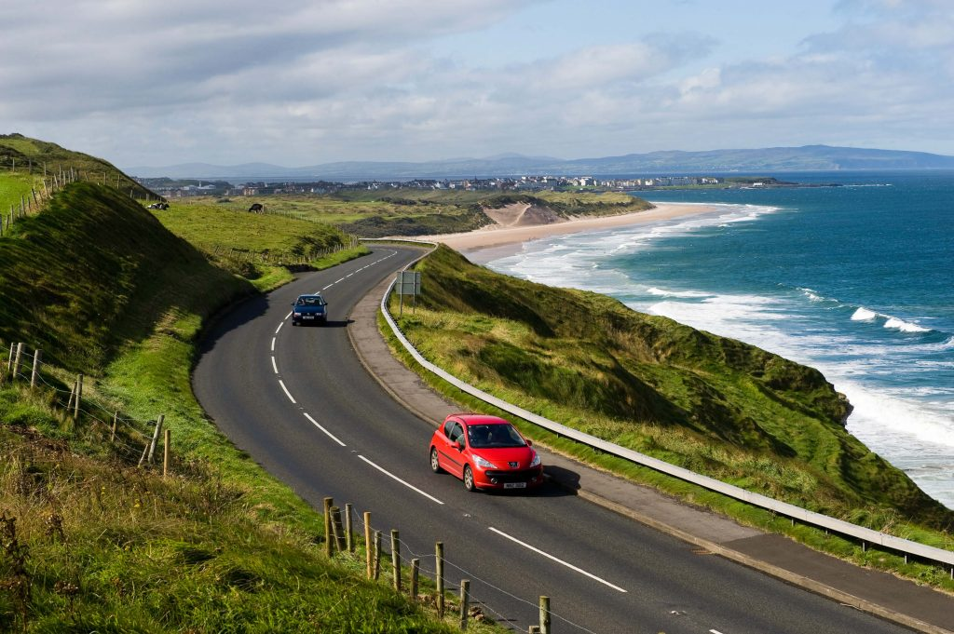
CA259 Assignment 2
Vanessa Ha (22107321)
Thomas Prior (22107355)

Slide 2

Second Hand Car Purchases in Ireland

Slide 3
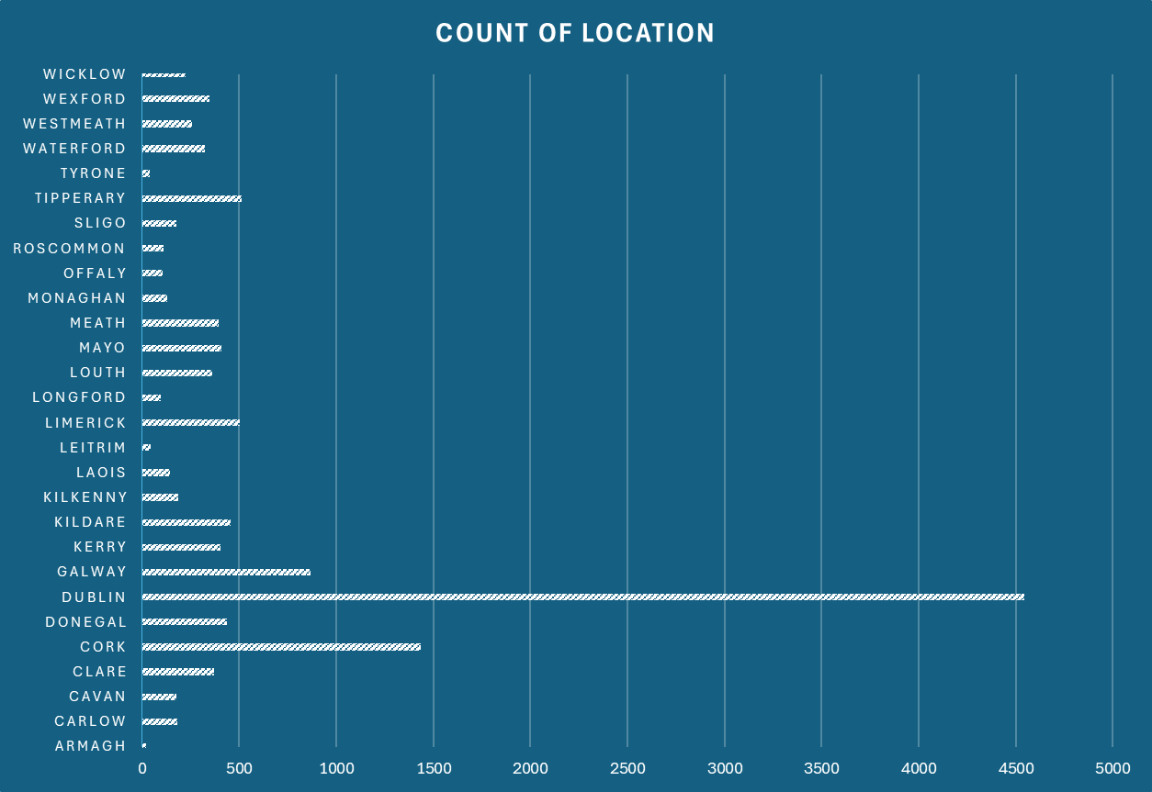
Dublin has the most purchases

Slide 4
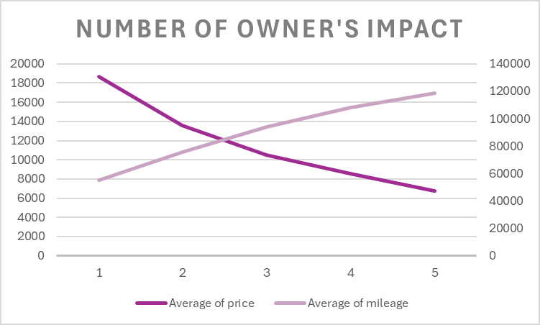
A car with more owners typically has higher mileage and a lower price.

Slide 5
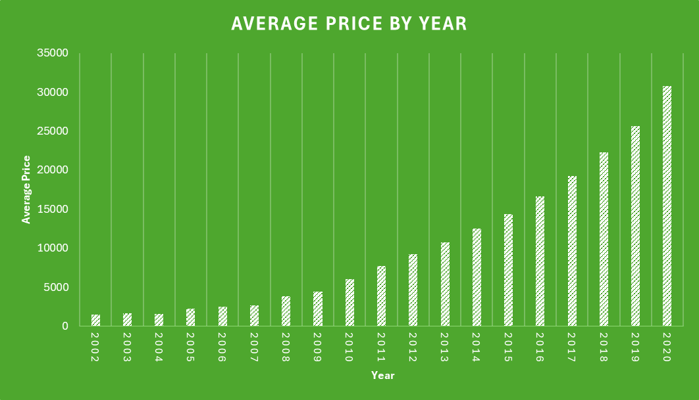

Slide 6
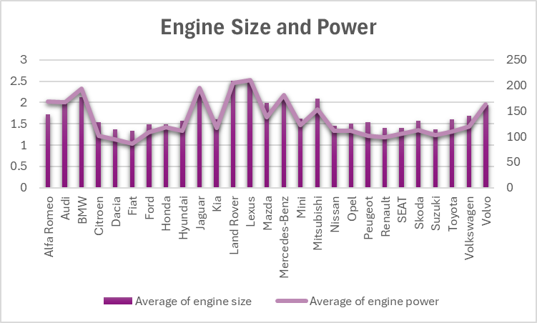

Slide 7
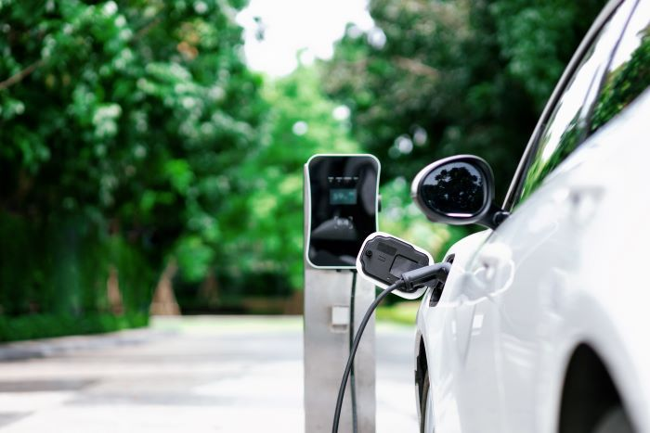
Electric/ Hybrid Vehicle Resale Market

Slide 8
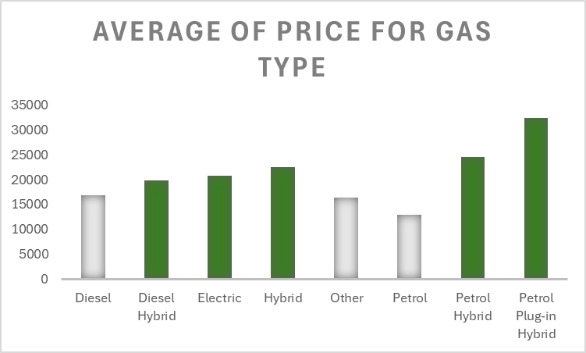

Slide 9
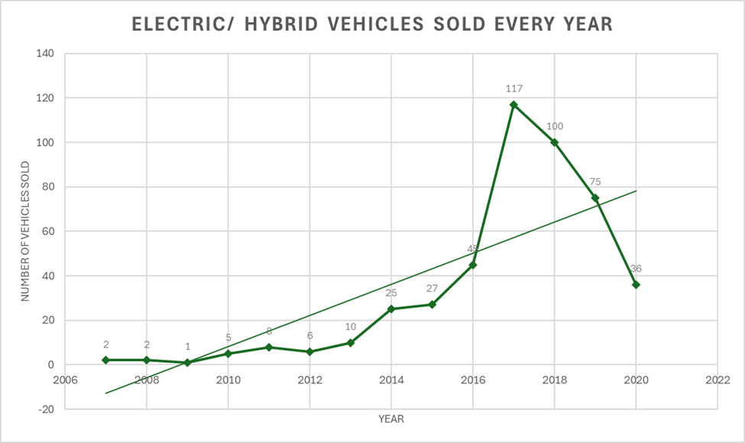
Factors for rise:
Environmental Incentives
New technology
Trendy
Factors for fall:
Still new product to the market - reluctant to sell
Covid-19

Slide 10
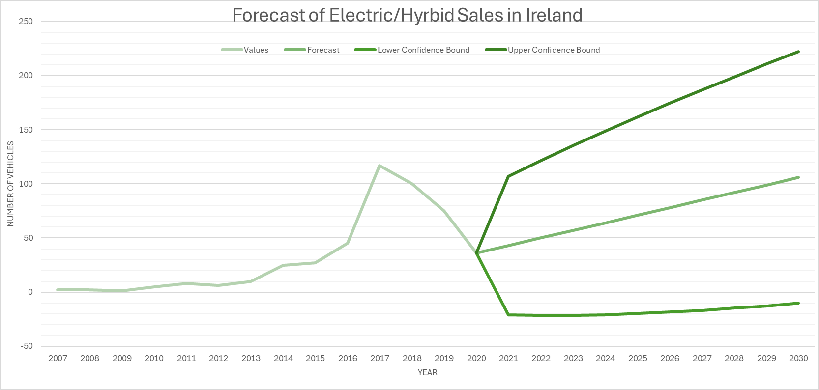

Slide 11
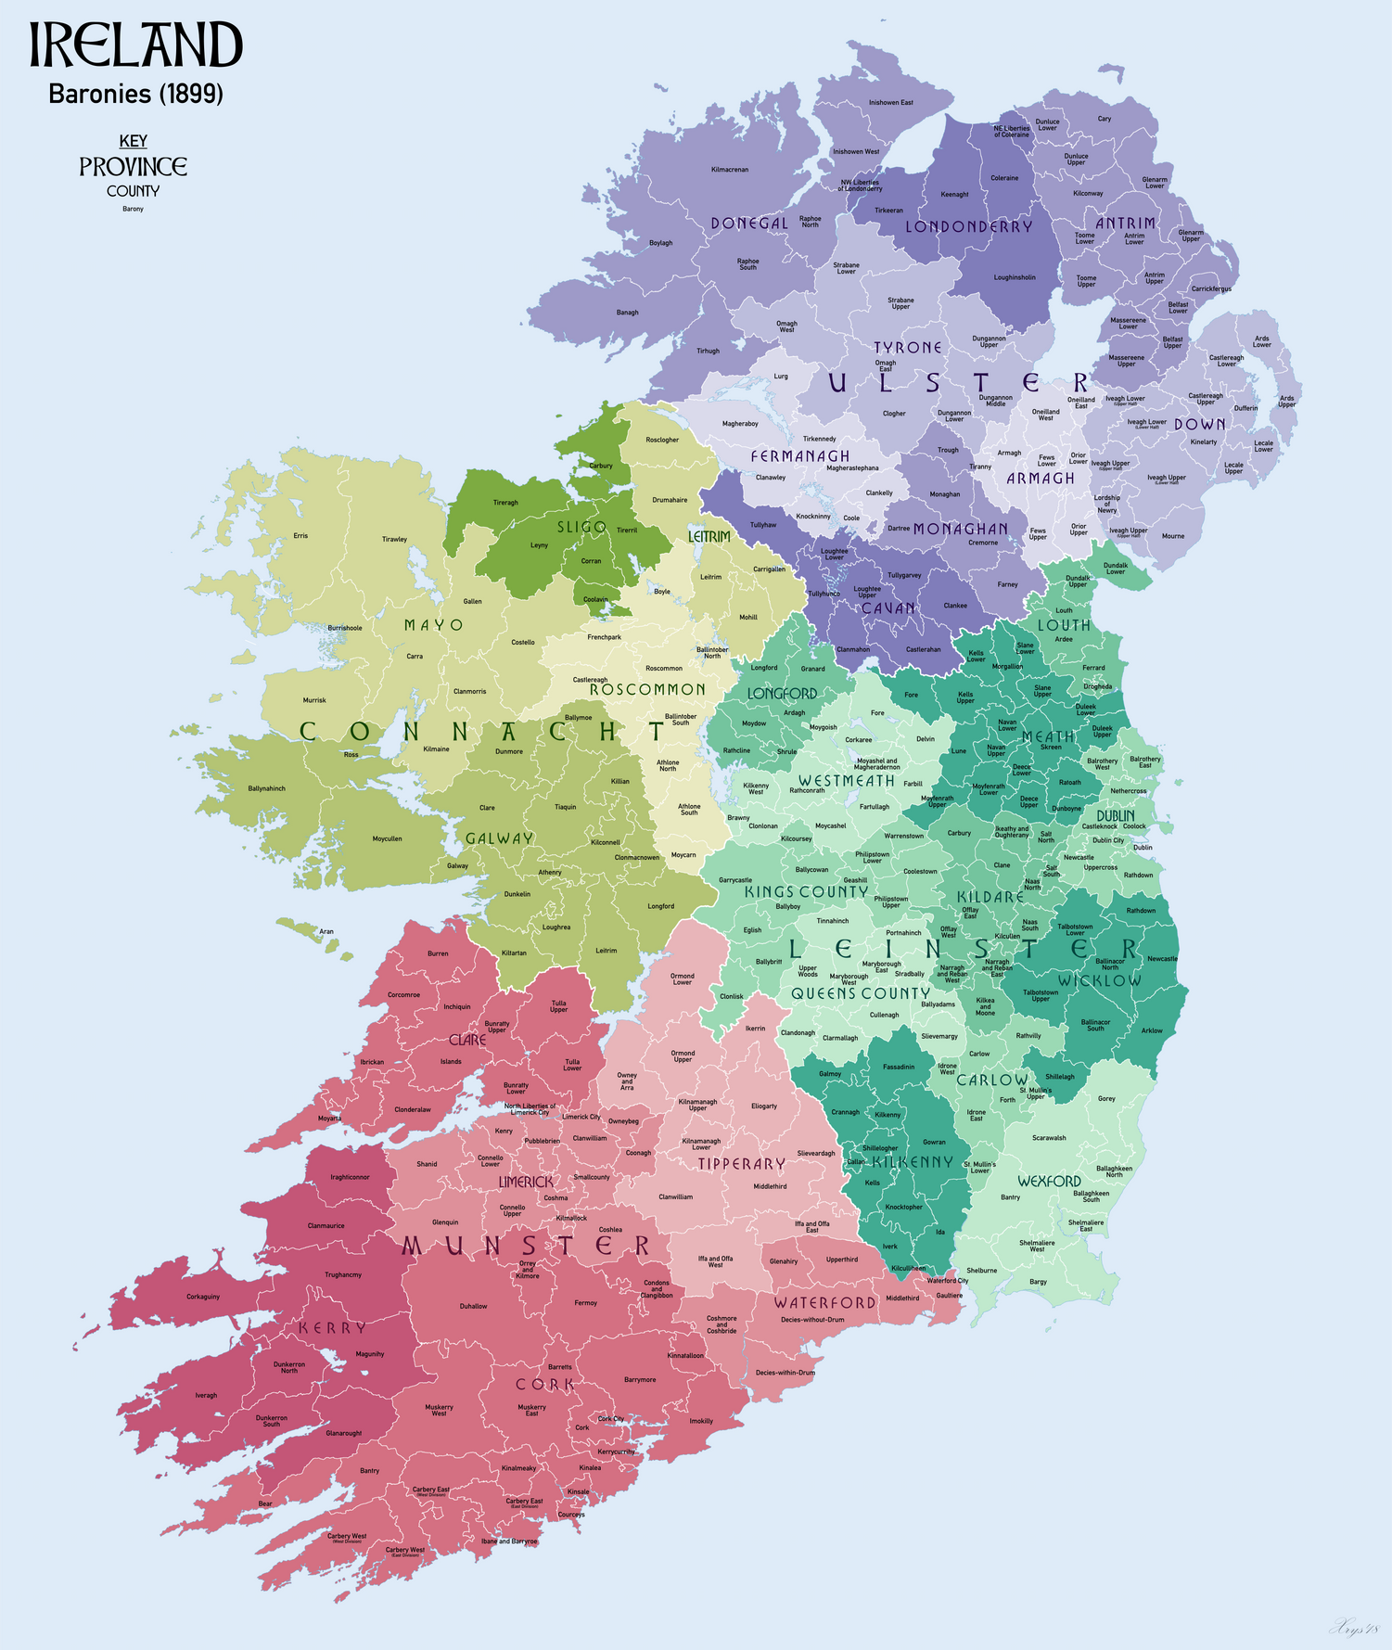
County Analysis

Slide 12
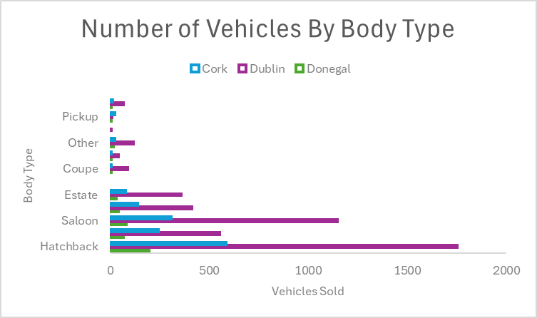
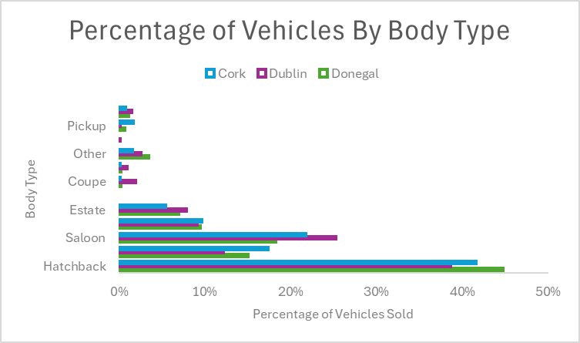
Predictions:
Donegal would have more pickups
Dublin would have the most estates and saloons
Significant differences between counties
Results:
There are no significant differences between counties in terms of body type on a percentage value

Slide 13
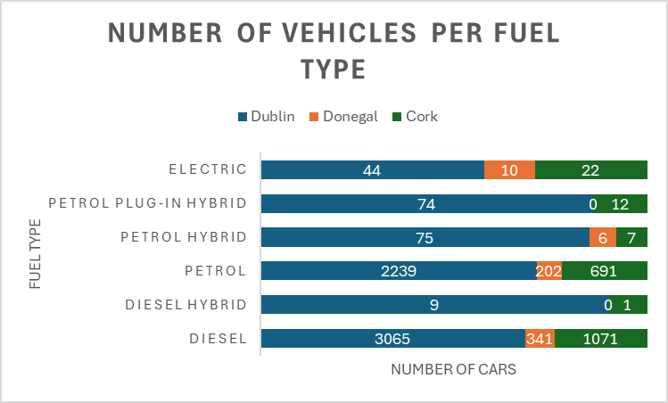
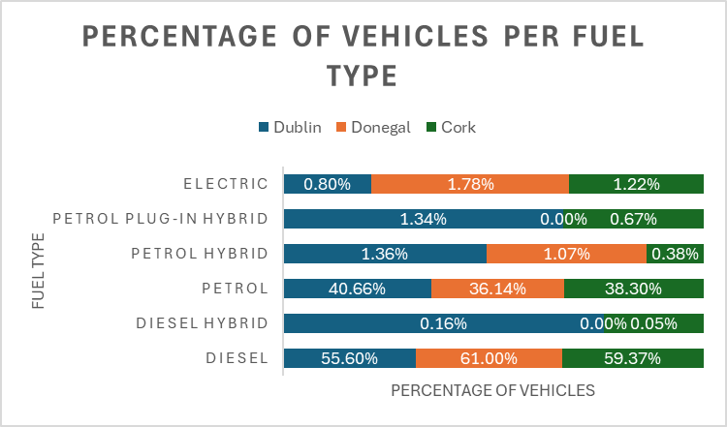

Slide 14
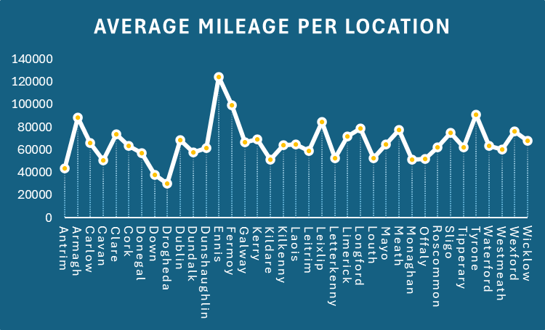
Prediction: Dense cities with good public transit see lower vehicle mileage due to more people using buses, trains, etc
Results: Data revealed that locations like Ennis, Fermoy, and Tyrone topped the charts for average mileage.
Reasons: Less public transport options, larger country area which meant residents likely rely more heavily on their vehicles

Slide 15

Intriguing Angles

Slide 16
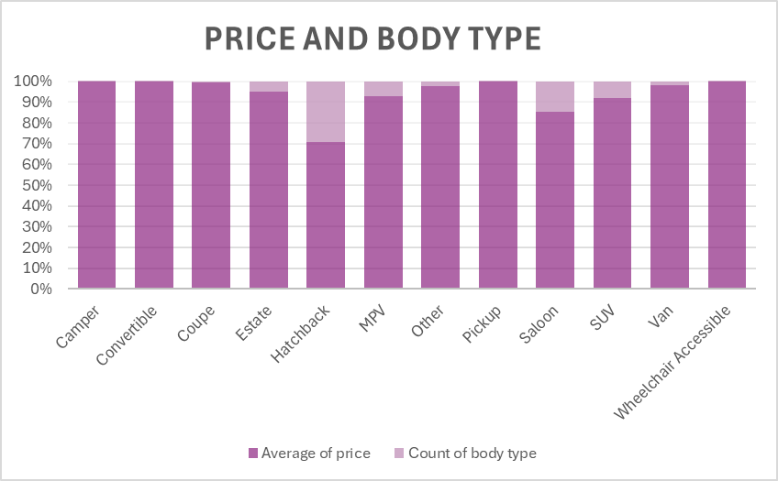
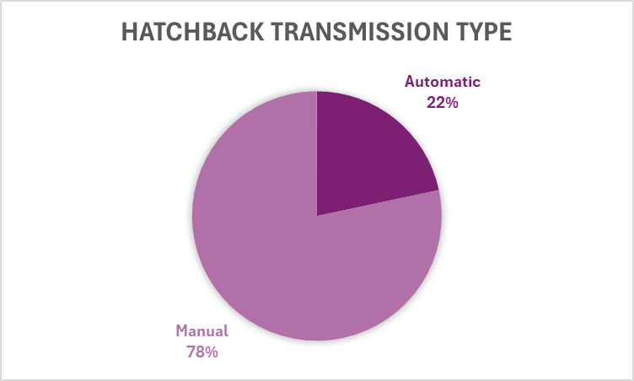

Slide 17
KEY FINDINGS
The data set appeared consistent with expectations
Electric vehicle sales power forward despite recent market disruptions
Little difference between county requirements
Hatchbacks are surging in popularity

Slide 18
Thank You

